Slide 1
A
C
B
B
A
B
A
C
B
A
C
C
Artificial Intelligence
Planning
Where logic-based representation of knowledge makes search problems more interesting
-Anish Raj, Dept. CE and IT, COEP

Slide 2
Outline
Introduction to Planning
Block World Environment
Situation Calculus
STRIPS
STRIP Representation
Forward Planning
Backward Planning
Goal Stack Planning
Sussman Anomaly
Nonlinear Planning
TWEAK Planner
Hierarchical Planning
State Representation
Action Representation
State Representation
Action Representation
Goal Representation
Situation Planning

Slide 3
Planning
The world is dynamic:
What is true now may not be true tomorrow
Changes in the world may be triggered by our activities
Problems:
Logic (FOL) as we had it referred to a static world. How to represent the change in the FOL ?
How to represent actions we can use to change the world?
Planning problem:
Find a sequence of actions that achieves some goal in this complex world
C
A
B
A
C
B
B
A
C
A
B
C

Slide 4
Components for Planning
Classical planning model is a tuple S = 〈S, s₀, S_{G}, A, f, c〉, where
Finite and discrete state space S
A known initial state s₀ ∈ S
A set S_{G} ⊆ S of goal states
Actions A(s) ⊆ A applicable in each s ∈ S
A deterministic transition function
s′ = f (a, s) for a ∈ A(s)
Non-negative action costs c(a, s)
Solution: sequence of applicable actions that maps s₀ into S_{G}

Slide 5
Components for Planning
Choose the best rule to apply next
Based on the best available heuristic information.
Appy the chosen rule to compute the new problem state:
S х A → S'
Detect when a solution has been found:
Employ techniques to make it totally correct.
Detect dead end so that they can be terminate:
Systems effort directed in more fruitful directions.

Slide 6
An Example Domain: The Block World
There is flat surface and square blocks (all are same size)
Blocks can be placed over the flat surface.
Blocks can be stacked one upon another.
There is a robot arm that can manipulate the blocks.
B
C
A
Represent the environment by predicates:
ON(C, A): Block C is on Block A
ONTABLE(A): Block A is on the table
CLEAR(C): There is nothing on top of Block C
HOLDING(B): The arm is holding Block B
HANDEMPTY: The arm is holding nothing

Slide 7
An Example Domain: The Block World
There is flat surface and square blocks (all are same size)
Blocks can be placed over the flat surface.
Blocks can be stacked one upon another.
There is a robot arm that can manipulate the blocks.
B
C
A
Action represented as:
PUTDOWN(B): Put block B down on the table
PICKUP(B): Pickup block B from the table and hold it
UNSTACK(C, A): Pickup block C from its current position on block A
STACK(C, A): Place block C on block A
B
C
A
B

Slide 8
An Example Domain: The Block World
There is flat surface and square blocks (all are same size)
Blocks can be placed over the flat surface.
Blocks can be stacked one upon another.
There is a robot arm that can manipulate the blocks.
C
A
B
Action represented as:
PUTDOWN(B): Put block B down on the table
PICKUP(B): Pickup block B from the table and hold it
UNSTACK(C, A): Pickup block C from its current position on block A
STACK(C, A): Place block C on block A
C
C
A
B

Slide 9
Planning Methods
Methods for modeling and solving a planning problem
Situation calculus
(extends FOL)
State space search
(STRIPS - restricted FOL)
Plan-based search
(for STRIPS)
GRAPHPLAN
propositional languages

Slide 10
Situation Calculus
Provides a framework for representing change, actions and reasoning about them
Situation calculus
Based on first-order logic
A situation variable models new states of the world
Action objects model activities
Uses inference methods developed for FOL to do the reasoning
The world is described by
Sequences of situations of the current state
Changes from one situation to another are caused by actions
The situation calculus allows us to
Describe the initial state and a goal state
Build the KB that describes the effect of actions (operators)
Prove that the KB and the initial state lead to a goal state
extracts a plan as side-effect of the proof
A
C
B
B
A
C
A
B
C

Slide 11
The Language of Planning Problems
Representation of states
Decompose the world into logical conditions and represent a state as a list of literals
Must be ground and function-free
Special variables:
s: objects of type situation
A
B
C
ON(A, TABLE, s0)
ON(B, TABLE, s0)
ON(C, TABLE, s0)
CLEAR(A, s0)
CLEAR(B, s0)
CLEAR(C, s0)
CLEAR(TABLE, s0)

Slide 12
The Language of Planning Problems
Representation of actions
Action functions: return actions.
Move(A, TABLE, B) represents a move action
Move(x, y ,z) represents an action schema
Special variables:
a: objects of type action
Two special function symbols of type situation
DO(a, s): denotes the situation obtained after performing an action a in situation s
Situation-dependent functions and relations (also called fluents)
Relation: On(x, y, s) – object x is on object y in situation s
Function: Above(x, s) – object that is above x in situation s

Slide 13
The Language of Planning Problems
Representation of goals
Goal is a partially specified state
Represented as a list of ground literals
State s satisfies goal g if s contains all the atoms in g (and possibly others)
Note: It is not necessary that the goal describes all relations
Clear(A, g)
A
B
C
ON(A, B, g)
ON(B, C, g)
ON(C, TABLE, g)

Slide 14
The Language of Planning Problems
Representation of goals
Assume a simpler goal ON(A,B, g)
A
B
C
3 Possible Goal Configuration: ON(A, B, g)
C
A
B
C
A
B
ON(A, TABLE, s0)
ON(B, TABLE, s0)
ON(C, TABLE, s0)
CLEAR(A, s0)
CLEAR(B, s0)
CLEAR(C, s0)
A
B
C

Slide 15
Knowledge base: Axioms
Knowledge base needed to support the reasoning:
Must represent changes in the world due to actions.
Two types of axioms:
Effect axioms
Changes in situations that result from actions
Frame axioms
Things preserved from the previous situation

Slide 16
Blocks World: Effect axioms
x
Moving x from y to z. MOVE (x, y, z)
Effect axioms:
Effect of move changes on ON relations
ON(x, y, s) ∧ CLEAR(x, s) ∧ CLEAR(z, s) → ON(x, z, DO (MOVE (x, y, z), s))
ON(x, y, s) ∧ CLEAR(x, s) ∧ CLEAR(z, s) → ¬ON(x, y, DO(MOVE (x, y, z), s))
Frame axioms:
ON relation:
ON(u, v, s) ∧ (u ≠ x) ∧ (v ≠ y) → ON(u, v, DO (MOVE (x, y, z), s))
u
v
y
z
u
x
v
y
z

Slide 17
Frame axioms:
Represent things that remain unchanged after an action
ON relation:
ON(u, v, s) ∧ (u ≠ x) ∧ (v ≠ y) → ON(u, v, DO (MOVE (x, y, z), s))
CLEAR relation:
CLEAR(u, s) ∧ (u ≠ z) → CLEAR(u, DO (MOVE (x, y, z), s))

Slide 18
Planning in Situation Calculus
Planning problem:
Find a sequence of actions that lead to a goal
Planning in situation calculus is converted to the theorem proving problem
Goal state: ∃s ON(A, B, s) ∧ ON(B, C, s) ∧ On(C, TABLE, s)
Possible inference approaches:
Inference rule approach
Resolution refutation
Plan (solution) is a byproduct of theorem proving.
Example: blocks world
A
B
C

Slide 19
Planning in Block World
Initial State Goal State
A
B
A
B
C
C
ON(A, TABLE, s0)
ON(B, TABLE, s0)
ON(C, TABLE, s0)
CLEAR(A, s0)
CLEAR(B, s0)
CLEAR(C, s0)
ON(A, B, g)
ON(B, C, g)
ON(C, TABLE, g)

Slide 20
Planning in Block World
B
A
B
C
A
C
s0
Action
s1
ON(A, TABLE, s0)
ON(B, TABLE, s0)
ON(C, TABLE, s0)
CLEAR(A, s0)
CLEAR(B, s0)
CLEAR(C, s0)
MOVE(B, TABLE, C)
S1 = DO(MOVE(B, TABLE, C), s0)
ON(A, TABLE, s1)
ON(B, C, s1)
¬ ON(B, TABLE, s1)
ON(C, TABLE, s1)
CLEAR(A, s1)
CLEAR(B, s1)
¬ CLEAR(C, s1)

Slide 21
Planning in Block World
A
B
B
A
C
C
s1
Action
s2
ON(A, TABLE, s1)
ON(B, C, s1)
¬ ON(B, TABLE, s1)
ON(C, TABLE, s1)
CLEAR(A, s1)
CLEAR(B, s1)
¬ CLEAR(C, s1)
MOVE(A, TABLE, B)
s2 = DO(MOVE(A, TABLE, B), s1)
ON(A, B, s2)
ON(B, C, s2)
ON(C, TABLE, s2)
¬ ON(A, TABLE, s2)
¬ ON(B, TABLE, s2)
CLEAR(A, s2)
¬ CLEAR(B, s1)
¬ CLEAR(C, s1)

Slide 22
Planning in Situation Calculus
Planning problem:
Find a sequence of actions that lead to a goal
Planning in situation calculus is converted to theorem proving.
Problems with situation calculus:
Large search space
Large number of axioms to be defined for one action
Proof may not lead to the best (shortest) plan.
Solution →
Complex state description and local action effects:
Avoid the enumeration and inference of every state component, focus on changes
Many possible actions:
Apply actions that make progress towards the goal
Understand what the effect of actions is and reason with the consequences
Sequences of actions in the plan can be too long
Many goals consists of independent or nearly independent sub-goals
Allow goal decomposition & divide and conquer strategies

Slide 23
STRIPS Framework
Defines a restricted version of the FOL representation language as compared to the situation calculus
Advantage: Leads to more efficient planning algorithms.
State-space search with structured representations of states, actions and goals
Action representation avoids the frame problem
STRIPS planning problem
Much like a standard search (planning) problem;

Slide 24
Action Planning
The goal of action planning is to choose actions and ordering relations among these actions to achieve specified goals
Search-based problem solving applied to 8-puzzle was one example of planning, but our description of this problem used specific data structures and functions
Here, we will develop a non-specific, logic-based language to represent knowledge about actions, states, and goals, and we will study how search algorithms can exploit this representation

Slide 25
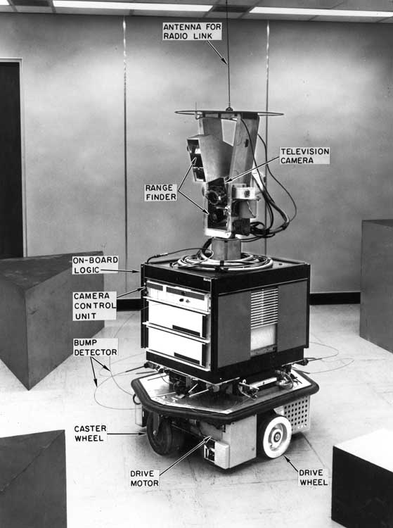
STRIPS
SHAKEY the Robot
STRIPS: a simple, still reasonably expressive planning language based on logic
Represent planning problems in STRIPS
Planning methods
Extensions of STRIPS
Like programming
Knowledge representation is still an art

Slide 26
Language of Classical Planning: STRIPS
A STRIPS Planning task is 5-tuple = 〈F, O, c, I, G〉:
F : finite set of atoms (boolean variables)
O: finite set of operators (actions) of form 〈Add, Del, Pre〉
(Add/Delete/Preconditions; subsets of atoms)
c : O → ℝ⁰⁺ captures operator cost
I: initial state ( subset of atoms )
G: goal description ( subset of atoms )

Slide 27
From Language to Models
A STRIPS Planning task Π = 〈F, O, c, I, G〉determines state model S(Π) where
the states s ∈ S are collections of atoms from F
the initial state s₀ is I
the goal states s are such that G ⊆ s
the actions a in A(s) are ops in O s.t. Pre(a) ⊆ s
the next state is s′ = s − Del(a) + Add(a)
action costs c(a, s) = c(a)
Solutions of S(Π) are plans of Π

Slide 28
STRIP: State
Decompose the world into logical conditions and represent a state as a conjunction of positive literals
No negated proposition, such as ¬Clean(A)
Closed-world assumption:
Every proposition that is not listed in a state is false in that state
No “or” connective
Such as On(A,B)∨On(B,C)
No variable, e.g., ∃x Clean(x)
A
B
C
Block(A) ∧ On(A, TABLE) ∧
Block(B) ∧ On(B, TABLE) ∧
Block(C) ∧ On(C, TABLE) ∧
Clear(A) ∧ Clear(B) ∧
Clear(C) ∧ Handempty
No uncertainty

Slide 29
STRIP: Goal State
Conjunction of positive literals
Goal is a partially specified state
Represented as a conjunction of ground literals
A goal G is achieved in a state S if all the propositions in G (called sub-goals) are also in S
Note: It is not necessary that the goal describes all relations
BLOCK(A)
A
B
C
On(A, B)
On(B, C)
On(C, TABLE)
Clear(C)

Slide 30
STRIP: Action
Specified in terms of the preconditions that must hold before it can be executed and the effects that ensue when it is executed
Action functions (Operator):
Unstack(A, B)
Preconditions:
Block(A) ∧ Block(B) ∧ Clear(A) ∧ On(A, B) ∧ Handempty
Effects: Two lists
Delete list: Handempty, Clear(A), On(A, B)
Add list: Holding(A), Clear(B)
Everything else remains untouched (is preserved)
A
B
C
A
B
C

Slide 31
STRIP: Action
Unstack(A, B)
P: Block(A) ∧ Block(B) ∧ Clear(A) ∧ On(A, B) ∧ Handempty
D: On(A, B), Clear(A), Handempty
A: Clear(B), Holding(A)
A
B
C
Block(A) ∧ Block(B) ∧ Block(C) ∧ On(C, TABLE) ∧ On(B, C)
∧ On(A, B) ∧ Clear(A) ∧ Handempty
A
Block(A) ∧ Block(B) ∧ Block(C) ∧ On(C, TABLE) ∧ On(B, C)
Block(A) ∧ Block(B) ∧ Block(C) ∧ On(C, TABLE) ∧ On(B, C)
∧ Clear(B) ∧ Holding(A)
Block(A) ∧ Block(B) ∧ Block(C) ∧ On(C, TABLE) ∧ On(B, C)
∧ Clear(B) ∧ Holding(A)
Block(A) ∧ Block(B) ∧ Block(C) ∧ On(C, TABLE) ∧ On(B, C)
∧ On(A, B) ∧ Clear(A) ∧ Handempty
B
C
the actions a in A(s) are ops in O s.t. Pre(a) ⊆ s
the next state is s′ = s − Del(a) + Add(a)

Slide 32
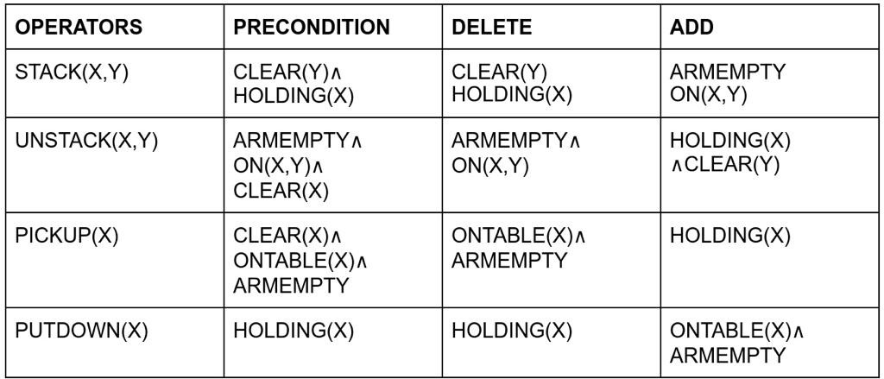
STRIP: Actions

Slide 33
Triangular Table
on(C, A)
1
clear(C)
hand empty
unstack(C, A)
2
holding(C)
putdown(C)
on(B, table)
hand empty
pickup(B)
3
4
clear(C)
holding(B)
stack(B, C)
on(A, table)
clear(A)
hand empty
pickup(A)
5
6
clear(B)
holding(A)
stack(A, B)
on(C, table)
on(B, C)
on(A,B)
7
clear(A)
0
1
2
3
4
5
6

Slide 34
STRIPS Planning
Objective
Find a sequence of operators (a plan) from the initial state to the state satisfying the goal
Two approaches to build a plan
Forward state space search (goal progression)
Start from what is known in the initial state and apply operators in the order they are applied
Backward state space search (goal regression)
Start from the description of the goal and identify actions that help to reach the goal

Slide 35
Forward Planning (Goal Progression)
Goal: On(B,A) ∧ On(C,B)
Pickup(B)
B
C
C
C
B
A
B
A
A
Unstack(C,A))
C
C
C
B
A
B
A
B
A
B
B
A
B
C
A
C
A
C

Slide 36
Need for an Accurate Heuristic
Forward planning simply searches the space of world states from the initial to the goal state
Imagine an agent with a large library of actions, whose goal is G, e.g., G = Have(Tea)
In general, many actions are applicable to any given state, so the branching factor is huge
In any given state, most applicable actions are irrelevant to reaching the goal Have(Tea)
Fortunately, an accurate consistent heuristic can be computed using planning graphs
How to determine which actions are relevant? How to use them?
→ Backward planning

Slide 37
Goal-Relevant Action
An action is relevant to achieving a goal if a proposition in its add list matches a sub-goal proposition
For example:
Stack(B,A) P = Holding(B) ∧ Block(B) ∧ Block(A) ∧ Clear(A) D = Clear(A), Holding(B),
A = On(B,A), Clear(B), Handempty
is relevant to achieving On(B,A)∧On(C,B)

Slide 38
Regression of a Goal
The regression of a goal G through an action A is the least constraining precondition R[G,A] such that:
If a state S satisfies R[G,A] then:
The precondition of A is satisfied in S
Applying A to S produces a state that satisfies G
G = On(B,A) ∧ On(C,B)
Stack(C,B)
P = Holding(C) ∧ Block(C) ∧ Block(B) ∧ Clear(B)
D = Clear(B), Holding(C)
A = On(C,B), Clear(C), Handempty
R[G,Stack(C,B)] = On(B,A) ∧ Holding(C) ∧ Block(C) ∧ Block(B) ∧ Clear(B)
C
B
A

Slide 39
Computation of R[G,A]
If any sub-goal of G is in A’s delete list then return False
Else
G’ ← Precondition of A
For every sub-goal SG of G do
If SG is not in A’s add list then add SG to G’
Return G’

Slide 40
Backward Planning
On(B,A) ∧ On(C,B)
C
A
B
Initial state

Slide 41
Backward Planning
On(B,A) ∧ On(C,B)
Stack(C,B)
C
On(B,A) ∧ Holding(C) ∧ Clear(B)
A
B
Initial state
Pickup(C)
On(B,A) ∧ Clear(B) ∧ Handempty ∧ Clear(C) ∧ On(C,Table)
Stack(B,A)
Clear(C) ∧ On(C,TABLE) ∧ Holding(B) ∧ Clear(A)
Pickup(B)
Clear(C) ∧ On(C,Table) ∧ Clear(A) ∧ Handempty ∧ Clear(B) ∧ On(B,Table)
Putdown(C)
Clear(A) ∧ Clear(B) ∧ On(B,Table) ∧ Holding(C)
Unstack(C,A)
Clear(B) ∧ On(B,Table) ∧ Clear(C) ∧ Handempty ∧ On(C,A)

Slide 42
Backward Planning
On(B,A) ∧ On(C,B)
Stack(C,B)
C
On(B,A) ∧ Holding(C) ∧ Clear(B)
A
B
Initial state
Pickup(C)
On(B,A) ∧ Clear(B) ∧ Handempty ∧ Clear(C) ∧ On(C,Table)
Stack(B,A)
Clear(C) ∧ On(C,TABLE) ∧ Holding(B) ∧ Clear(A)
Pickup(B)
Clear(C) ∧ On(C,Table) ∧ Clear(A) ∧ Handempty ∧ Clear(B) ∧ On(B,Table)
Putdown(C)
Clear(A) ∧ Clear(B) ∧ On(B,Table) ∧ Holding(C)
Unstack(C,A)
Clear(B) ∧ On(B,Table) ∧ Clear(C) ∧ Handempty ∧ On(C,A)

Slide 43
Search Tree
Backward planning searches a space of goals from the original goal of the problem to a goal that is satisfied in the initial state
There are often much fewer actions relevant to a goal than there are actions applicable to a state
Smaller branching factor than in forward planning
The lengths of the solution paths are the same

Slide 44
Consistent Heuristic for Backward Planning
A consistent heuristic is obtained as follows :
Pre-compute the planning graph of the initial state until it levels off
For each node N added to the search tree, set h(N) to the level cost of the goal associated with N
If the goal associated with N can’t be satisfied in any set S_{k} of the planning graph, it can’t be achieved, so prune it!
A single planning graph is computed

Slide 45
How Does Backward Planning Detect Dead-Ends?
On(B,A) ∧ On(C,B)
Stack(C,B)

Slide 46
How Does Backward Planning Detect Dead-Ends?
On(B,A) ∧ On(C,B)
Stack(B,A)
Holding(B) ∧ Clear(A) ∧ On(C,B)
Stack(C,B)
Holding(B) ∧ Clear(A) ∧ Holding(C) ∧ Clear (B)
Pick(B) [delete list contains Clear(B)]
False

Slide 47
How Does Backward Planning Detect Dead-Ends?
On(B,A) ∧ On(C,B)
Stack(B,A)
Holding(B) ∧ Clear(A) ∧ On(C,B)
A state constraint such as
Holding(x) → ¬(∃y)On(y,x) would have made it possible to prune the path earlier

Slide 48
STRIPS Goal Stack Planning
The original STRIPS system used a goal stack to control its search.
The system has
Database
Goal stack
Goal Stack
Database
Goal
Operators to satisfy the Goal
Current Situation
Specification of
Operators / Actions
+

Slide 49
STRIPS Goal Stack Planning
Place goal in goal stack
Considering top Goal1
Place onto its sub-goals
Then try to solve sub-goal
GoalS1-2
Continue…
Goal Stack
Database
Goal
Operators to satisfy the Goal
Current Situation
Specification of
Operators / Actions
+
 | Goal1
 | Goal1-2
 | Goal1-1
 | Goal1

Slide 50
Stack Manipulation Rules
If on TOP of the Stack | Then Do
Compound or Single goal Matching the current state description | Remove it
Compound goal Not matching the current state description | Keep original compound goal on stack List the unsatisfied component goals on the stack in some new order
Single-literal goal Not matching the current state description | Find new action who's instantiated add-list includes the goal Replace the goal with the action Place the action’s precondition formula on top of stack
Action | Remove action from stack Update database using action Keep track of action (for solution)
Nothing | Stop

Slide 51
Step: 1
A
C
C
A
B
B
 | On(A, C) ∧ On(C, B)
 | Goal Stack
Clear(B)
On(C,A)
Clear(C)
On(A, TABLE)
On(B, TABLE)
Handempty
Database
Solution

Slide 52
Step: 2
C
A
B
C
 | On(C, B)
 | On(A, C)
 | On(A, C) ∧ On(C, B)
 | Goal Stack
Clear(B)
On(C,A)
Clear(C)
On(A, TABLE)
On(B, TABLE)
Handempty
Database
Solution

Slide 53
Step: 2
C
C
B
B
 | On(C, B)
 | On(A, C)
 | On(A, C) ∧ On(C, B)
 | Goal Stack
Clear(B)
On(C,A)
Clear(C)
On(A, TABLE)
On(B, TABLE)
Handempty
Database
Solution

Slide 54
Step: 3
C
C
B
B
 | Holding(C) ∧ Clear(B)
 | Stack(C, B)
 | On(A, C)
 | On(A, C) ∧ On(C, B)
 | Goal Stack
Clear(B)
On(C,A)
Clear(C)
On(A, TABLE)
On(B, TABLE)
Handempty
Database
Solution

Slide 55
Step: 4
C
C
B
B
 | Clear(B)
 | Holding(C)
 | Holding(C) ∧ Clear(B)
 | Stack(C, B)
 | On(A, C)
 | On(A, C) ∧ On(C, B)
 | Goal Stack
Clear(B)
On(C,A)
Clear(C)
On(A, TABLE)
On(B, TABLE)
Handempty
Database
Solution

Slide 56
Step: 5
C
C
B
B
 | Clear(B)
 | Holding(C)
 | Holding(C) ∧ Clear(B)
 | Stack(C, B)
 | On(A, C)
 | On(A, C) ∧ On(C, B)
 | Goal Stack
Clear(B)
On(C,A)
Clear(C)
On(A, TABLE)
On(B, TABLE)
Handempty
Database
Solution

Slide 57
Step: 5
C
C
A
A
 | Holding(C)
 | Holding(C) ∧ Clear(B)
 | Stack(C, B)
 | On(A, C)
 | On(A, C) ∧ On(C, B)
 | Goal Stack
Clear(B)
On(C,A)
Clear(C)
On(A, TABLE)
On(B, TABLE)
Handempty
Database
Solution

Slide 58
Step: 6
C
C
A
A
 | On(C, A) ∧ Clear(C) ∧ Handempty
 | Unstack(C, A)
 | Holding(C) ∧ Clear(B)
 | Stack(C, B)
 | On(A, C)
 | On(A, C) ∧ On(C, B)
 | Goal Stack
Clear(B)
On(C,A)
Clear(C)
On(A, TABLE)
On(B, TABLE)
Handempty
Database
Solution

Slide 59
Step: 7
C
C
A
A
 | On(C, A) ∧ Clear(C) ∧ Handempty
 | Unstack(C, A)
 | Holding(C) ∧ Clear(B)
 | Stack(C, B)
 | On(A, C)
 | On(A, C) ∧ On(C, B)
 | Goal Stack
Clear(B)
On(C,A)
Clear(C)
On(A, TABLE)
On(B, TABLE)
Handempty
Database
Solution

Slide 60
Step: 8
C
C
Unstack(C,A):
Add - [Holding(C), Clear(A)]
Delete -[Handempty, Clear(C), On(C,A)]
A
A
 | Unstack(C, A)
 | Holding(C) ∧ Clear(B)
 | Stack(C, B)
 | On(A, C)
 | On(A, C) ∧ On(C, B)
 | Goal Stack
Clear(B)
On(C,A)
Clear(C)
On(A, TABLE)
On(B, TABLE)
Handempty
Database
Solution

Slide 61
Step: 8
C
C
Unstack(C,A):
Add - [Holding(C), Clear(A)]
Delete -[Handempty, Clear(C), On(C,A)]
A
A
 | Holding(C) ∧ Clear(B)
 | Stack(C, B)
 | On(A, C)
 | On(A, C) ∧ On(C, B)
 | Goal Stack
Clear(B)
On(A, TABLE)
On(B, TABLE)
Clear(A)
Holding(C)
Database
Solution | Unstack(C, A)

Slide 62
Step: 9
C
C
A
A
 | Holding(C) ∧ Clear(B)
 | Stack(C, B)
 | On(A, C)
 | On(A, C) ∧ On(C, B)
 | Goal Stack
Clear(B)
On(A, TABLE)
On(B, TABLE)
Clear(A)
Holding(C)
Database
Solution | Unstack(C, A)

Slide 63
Step: 10
C
C
B
B
 | Stack(C, B)
 | On(A, C)
 | On(A, C) ∧ On(C, B)
 | Goal Stack
Clear(B)
On(A, TABLE)
On(B, TABLE)
Clear(A)
Holding(C)
Database
Solution | Unstack(C, A)

Slide 64
Step: 10
C
C
Stack(C,B):
Add - [Handempty, On(C,B), Clear(C)]
Delete - [Holding(C), Clear(B)]
B
B
 | Stack(C, B)
 | On(A, C)
 | On(A, C) ∧ On(C, B)
 | Goal Stack
Clear(B)
On(A, TABLE)
On(B, TABLE)
Clear(A)
Holding(C)
Database
Solution | Unstack(C, A)

Slide 65
Step: 11
A
A
Stack(C,B):
Add - [Handempty, On(C,B), Clear(C)]
Delete - [Holding(C), Clear(B)]
C
C
 | On(A, C)
 | On(A, C) ∧ On(C, B)
 | Goal Stack
On(A, TABLE)
On(B, TABLE)
Clear(A)
Clear(C)
On(C, B)
Handempty
Database
Solution | Unstack(C, A), Stack(C, B)

Slide 66
Step: 12
A
A
C
C
 | Holding(A) ∧ Clear(C)
 | Stack(A, C)
 | On(A, C) ∧ On(C, B)
 | Goal Stack
On(A, TABLE)
On(B, TABLE)
Clear(A)
Clear(C)
On(C, B)
Handempty
Database
Solution | Unstack(C, A), Stack(C, B)

Slide 67
A
A
 | Holding(A)
 | Holding(A) ∧ Clear(C)
 | Stack(A, C)
 | On(A, C) ∧ On(C, B)
 | Goal Stack
On(A, TABLE)
On(B, TABLE)
Clear(A)
Clear(C)
On(C, B)
Handempty
Database
Solution | Unstack(C, A), Stack(C, B)

Slide 68
Step: 13
A
A
 | On(A, TABLE) ∧ Clear(A) ∧ Handempy
 | Pickup(A)
 | Holding(A) ∧ Clear(C)
 | Stack(A, C)
 | On(A, C) ∧ On(C, B)
 | Goal Stack
On(A, TABLE)
On(B, TABLE)
Clear(A)
Clear(C)
On(C, B)
Handempty
Database
Solution | Unstack(C, A), Stack(C, B)

Slide 69
Step: 14
A
A
 | On(A, TABLE) ∧ Clear(A) ∧ Handempy
 | Pickup(A)
 | Holding(A) ∧ Clear(C)
 | Stack(A, C)
 | On(A, C) ∧ On(C, B)
 | Goal Stack
On(A, TABLE)
On(B, TABLE)
Clear(A)
Clear(C)
On(C, B)
Handempty
Database
Solution | Unstack(C, A), Stack(C, B)

Slide 70
Step: 16
A
Pickup(A):
Add - [Holding(A)]
Delete - [On(A, TABLE), Clear(A), Handempty]
A
 | Pickup(A)
 | Holding(A) ∧ Clear(C)
 | Stack(A, C)
 | On(A, C) ∧ On(C, B)
 | Goal Stack
On(A, TABLE)
On(B, TABLE)
Clear(A)
Clear(C)
On(C, B)
Handempty
Database
Solution | Unstack(C, A), Stack(C, B)

Slide 71
Step: 17
A
Pickup(A):
Add - [Holding(A)]
Delete - [On(A, TABLE), Clear(A), Handempty]
A
 | Holding(A) ∧ Clear(C)
 | Stack(A, C)
 | On(A, C) ∧ On(C, B)
 | Goal Stack
On(B, TABLE)
Clear(C)
On(C, B)
Holding(A)
Database
Solution | Unstack(C, A), Stack(C, B), Pickup(A)

Slide 72
Step: 17
A
A
 | Holding(A) ∧ Clear(C)
 | Stack(A, C)
 | On(A, C) ∧ On(C, B)
 | Goal Stack
On(B, TABLE)
Clear(C)
On(C, B)
Holding(A)
Database
Solution | Unstack(C, A), Stack(C, B), Pickup(A)

Slide 73
Step: 18
A
A
Stack(A,C):
Add - [Handempty, On(A,C), Clear(A)]
Delete - [Holding(A), Clear(C)]
C
C
 | Stack(A, C)
 | On(A, C) ∧ On(C, B)
 | Goal Stack
On(B, TABLE)
Clear(C)
On(C, B)
Holding(A)
Database
Solution | Unstack(C, A), Stack(C, B), Pickup(A)

Slide 74
Step: 18
A
A
Stack(A,C):
Add - [Handempty, On(A,C), Clear(A)]
Delete - [Holding(A), Clear(C)]
C
C
 | On(A, C) ∧ On(C, B)
 | Goal Stack
On(B, TABLE)
On(C, B)
Clear(A)
On(A, C)
Handempty
Database
Solution | Unstack(C, A), Stack(C, B), Pickup(A), Stack(A, C)

Slide 75
Step: 19
A
A
C
C
 | On(A, C) ∧ On(C, B)
 | Goal Stack
On(B, TABLE)
On(C, B)
Clear(A)
On(A, C)
Handempty
Database
Solution | Unstack(C, A), Stack(C, B), Pickup(A), Stack(A, C)

Slide 76
Step: 20
C
A
A
C
C
C
C
A
B
A
B
A
B
B
B
 | Goal Stack
On(B, TABLE)
On(C, B)
Clear(A)
On(A, C)
Handempty
Database
Solution | Unstack(C, A), Stack(C, B), Pickup(A), Stack(A, C)

Slide 77
Stack Manipulation Rules
If on TOP of the Stack | Then Do
Compound or Single goal Matching the current state description | Remove it
Compound goal Not matching the current state description | Keep original compound goal on stack List the unsatisfied component goals on the stack in some new order
Single-literal goal Not matching the current state description | Find new action who's instantiated add-list includes the goal Replace the goal with the action Place the action’s precondition formula on top of stack
Action | Remove action from stack Update database using action Keep track of action (for solution)
Nothing | Stop

Slide 78
Goal Stack
C
A
C
B
B
A
B
A
B
A
C
B
A
C
C
This method may fail to find the good solution
There are two way that could begin to solve this problem
 | On(B, C)
 | On(A, B)
 | On(A, B) ∧ On(B, C)
 | Goal Stack
Clear(B)
On(C,A)
Clear(C)
On(A, TABLE)
On(B, TABLE)
Handempty
Database
Solution | Unstack(C, A), Putdown (C), Pickup(B), Stack(B, C), Pickup(A), Stack(A, C)

Slide 79
Goal Stack
C
A
C
B
B
A
B
A
B
A
C
B
A
C
C
 | On(B, C)
 | On(A, B)
 | On(A, B) ∧ On(B, C)
 | Goal Stack
 | On(A, B)
 | On(B, C)
 | On(A, B) ∧ On(B, C)
 | Goal Stack
1st
2nd

Slide 80
Goal Stack
 | On(C, A) ∧ Clear(C) ∧ Handempty
 | Unstack(C, A)
 | Handempty
 | Clear(A) ∧ Handempty
 | Pickup(A)
 | Clear(B) ∧ Holding(A)
 | Stack(A, B)
 | On(B, C)
 | On(A, B) ∧ On(B, C)
 | Goal Stack
 | Holding(C)
 | Putdown(C)
 | Handempty
 | Clear(A) ∧ Handempty
 | Pickup(A)
 | Clear(B) ∧ Holding(A)
 | Stack(A, B)
 | On(B, C)
 | On(A, B) ∧ On(B, C)
 | Goal Stack
C
C
A
B
A
B
A
 | On(B, C)
 | On(A, B) ∧ On(B, C)
 | Goal Stack
A
C
B
C
B
Solution | Unstack(C, A), Putdown (C), Pickup(A), Stack(A, B)

Slide 81
Goal Stack
Difference between Gol and Current State
Unstack(A, B)
C
A
C
A
A
B
A
B
C
B
C
B
 | On(B, C)
 | On(A, B) ∧ On(B, C)
 | Goal Stack
 | On(A, B) ∧ On(B, C)
 | Goal Stack
A
B
A
A
B
B
B
C
B
A
C
B
A
C
A
C
C
C
Pickup(A) Stack(A, B)
Sussman Anomaly
Solution | Unstack(C, A), Putdown (C), Pickup(A), Stack(A, B), Unstack(A, B), Putdown(A), Pickup(B), Stack(B, C)

Slide 82
Linear vs Nonlinear Planning
Goal Stack Planning
Problem involving conjoined goals
Solve the goal one at time, in order
Plan contain a sequence of operators for attending first sub-goal followed by second sub-goal.
Advantages
Reduced search space, since goals are solved one at a time
Advantageous if goals are (mainly) independent
Linear planning is sound
Difficulty
Ordering of sub-goals may leads to suboptimal or incomplete.
Poor irreversible actions
Operator used to solve the sub-goal may interfere with the solution of previous sub-goal.
Solution
Nonlinear Planning
Multiple sub-goals are solved simultaneously.
Use the set instead of goal stack
Include in the search space all possible subgoal orderings
Handles goal interactions by interleaving
Advantages
Non-linear planning is sound
Non-linear planning is complete
Non-linear planning may be optimal with respect to plan length (depending on search strategy employed)
Disadvantages
Larger search space, since all possible goal orderings may have to be considered
Somewhat more complex algorithm
More bookkeeping

Slide 83
TWEAK Representation
Action Pickup(A)
Preconditions Clear(B) ∧ On(A, TABLE) ∧ Handempty
Postconditions Hold(A) ∧ ¬ On(A, TABLE) ∧ ¬ Handempty
Action Stack (A, B)
Preconditions Clear(B) ∧ Holding(A)
Postconditions Handempty ∧ On(A, B) ∧ ¬ Clear(B) ∧ ¬ Holding(A)
A
B
B
A
C
C
A
A
B
B
C
C

Slide 84
Heuristic Planning using Constraint Posting: TWEAK
Heuristic Operations for plan modification:
Step Addition: Creating new step for plan
Promotion: Constraint one step to come before another in a final plan
DeClobbeering: Placing one step S2 between two old steps S1 and S3 such that S2 reasserts some precondition of S3 that was negated by S1
Simple Binding: Assigning a value to a variable, in order to ensure the precondition of some step
Separation: Preventing the assignment of certain values to a variable.

Slide 85
Block World Example
A
C
B
A
B
C
On(A, TABLE) ∧ On(C, A)
On(B, TABLE) ∧ Handempty
On(A, B) ∧ On(B, C)

Slide 86
A
B
B
C
A
B
B
C
A
B
A
B
B
C
B
C
Clear(B) | Clear(C)
*Holding(A) | *Holding(B)
Stack(A, B) | Stack(B, C)
Handempty | Handempty
On(A, B) | On(B, C)
¬Clear(B) | ¬Clear(C)
¬Holding(A) | ¬Holding(B)
*Clear(A) | *Clear(B)
On(A, TABLE) | On(B, TABLE)
*Handempty | *Handempty
Pickup(A) | Pickup(B)
Holding(A) | Holding(B)
¬On(A, TABLE) | ¬On(B, TABLE)
¬Handempty | ¬Handempty
Plan = {Stack (A, B), Stack(B, C)}
Plan = {Stack A, B), Stack(B, C), Pickup(A), Pickup(B)}

Slide 87
Plan = {Stack A, B), Stack(B, C), Pickup(A), Pickup(B)}
Pickup(A) ← Stack(A, B)
Pickup(B) ← Stack(B, C)
A
B
B
C
A
B
B
C
A
B
A
B
B
C
B
C
 |  | *Clear(A) | *Clear(B)
Clear(B) | Clear(C) | On(A, TABLE) | On(B, TABLE)
*Holding(A) | *Holding(B) | *Handempty | *Handempty
Stack(A, B) | Stack(B, C) | Pickup(A) | Pickup(B)
Handempty | Handempty | Holding(A) | Holding(B)
On(A, B) | On(B, C) | ¬On(A, TABLE) | ¬On(B, TABLE)
¬Clear(B) | ¬Clear(C) | ¬Handempty | ¬Handempty
¬Holding(A) | ¬Holding(B)

Slide 88
Pickup(A) ← Stack(A, B)
Pickup(B) ← Stack(B, C)
Plan = {Pickup(A), Stack (A, B), Pickup(B), Stack(B, C)}
C
A
B
A
B
A
B
B
B
C
C
A
B
A
B
B
B
C
C
*Clear(A) |  | *Clear(B)
On(A, TABLE) | Clear(B) | On(B, TABLE) | Clear(C)
*Handempty | *Holding(A) | *Handempty | *Holding(B)
Pickup(A) | Stack(A, B) | Pickup(B) | Stack(B, C)
Holding(A) | Handempty | Holding(B) | Handempty
¬On(A, TABLE) | On(A, B) | ¬On(B, TABLE) | On(B, C)
¬Handempty | ¬Clear(B) | ¬Handempty | ¬Clear(C)
 | ¬Holding(A)

Slide 89
Pickup(B) ← Stack(A, B)
Plan = {Pickup(A), Pickup(B), Stack (A, B), Stack(B, C)}
C
A
B
A
B
A
B
B
C
B
C
A
B
A
B
B
C
B
C
*Clear(A) | *Clear(B)
On(A, TABLE) | On(B, TABLE) | Clear(B) | Clear(C)
*Handempty | *Handempty | *Holding(A) | *Holding(B)
Pickup(A) | Pickup(B) | Stack(A, B) | Stack(B, C)
Holding(A) | Holding(B) | Handempty | Handempty
¬On(A, TABLE) | ¬On(B, TABLE) | On(A, B) | On(B, C)
¬Handempty | ¬Handempty | ¬Clear(B) | ¬Clear(C)
 |  | ¬Holding(A)

Slide 90
Pickup(B) ← Pickup(A)
Plan = {Pickup(B), Pickup(A), Stack A, B), Stack(B, C)}
C
A
B
A
B
B
C
A
B
B
C
B
A
A
B
C
B
B
C
*Clear(B) | *Clear(A)
On(B, TABLE) | On(A, TABLE) | Clear(B) | Clear(C)
*Handempty | *Handempty | *Holding(A) | *Holding(B)
Pickup(B) | Pickup(A) | Stack(A, B) | Stack(B, C)
Holding(B) | Holding(A) | Handempty | Handempty
¬On(B, TABLE) | ¬On(A, TABLE) | On(A, B) | On(B, C)
¬Handempty | ¬Handempty | ¬Clear(B) | ¬Clear(C)
 |  | ¬Holding(A)

Slide 91
Pickup(B) ← Stack(B, C) ← Pickup(A)
Plan = {Pickup(B), Stack(B, C), Pickup(A), Stack A, B)}
C
A
B
B
A
B
C
C
A
B
B
B
A
B
A
C
C
B
B
Clear(B) |  | *Clear(A)
On(B, TABLE) | Clear(C) | On(A, TABLE) | Clear(B)
Handempty | Holding(B) | *Handempty | *Holding(A)
Pickup(B) | Stack(B, C) | Pickup(A) | Stack(A, B)
Holding(B) | Handempty | Holding(A) | Handempty
¬On(B, TABLE) | On(B, C) | ¬On(A, TABLE) | On(A, B)
¬Handempty | ¬Clear(C) | ¬Handempty | ¬Clear(B)
 |  |  | ¬Holding(A)

Slide 92
Unstack(x, A)
Plan = {Pickup(B), Stack(B, C), Pickup(A), Stack A, B), Unstack(x, A) }
x = C in step Unstack(x, A)
C
A
B
B
A
x
B
C
C
A
B
B
A
B
A
x
B
A
C
C
B
B
A
Clear(B) |  | *Clear(A) |  | On(x, A)
On(B, TABLE) | Clear(C) | On(A, TABLE) | Clear(B) | Clear(x)
Handempty | Holding(B) | *Handempty | *Holding(A) | Handempty
Pickup(B) | Stack(B, C) | Pickup(A) | Stack(A, B) | Unstack(x, A)
Holding(B) | Handempty | Holding(A) | Handempty | ¬Handempty
¬On(B, TABLE) | On(B, C) | ¬On(A, TABLE) | On(A, B) | Clear(A)
¬Handempty | ¬Clear(C) | ¬Handempty | ¬Clear(B) | Holding(x)
 |  |  | ¬Holding(A) | ¬On(x, A)

Slide 93
Unstack(C, A) ← Pickup(B) ← Stack(B, C) ← Pickup(A) ← Stack(A, B)
Plan = {Unstack(x, A), Pickup(B), Stack(B, C), Pickup(A), Stack A, B)}
C
A
B
B
A
C
A
B
C
C
A
B
B
C
B
A
B
A
A
C
C
B
B
On(C, A) | Clear(B) |  | *Clear(A)
Clear(C) | On(B, TABLE) | Clear(C) | On(A, TABLE) | Clear(B)
Handempty | Handempty | Holding(B) | *Handempty | *Holding(A)
Unstack(C, A) | Pickup(B) | Stack(B, C) | Pickup(A) | Stack(A, B)
¬Handempty | Holding(B) | Handempty | Holding(A) | Handempty
Clear(A) | ¬On(B, TABLE) | On(B, C) | ¬On(A, TABLE) | On(A, B)
Holding(C) | ¬Handempty | ¬Clear(C) | ¬Handempty | ¬Clear(B)
¬On(C, A) |  |  |  | ¬Holding(A)

Slide 94
Unstack(C, A) ← Putdown(C) ← Pickup(B)
Plan = {Unstack(C, A), Putdown(C), Pickup(B), Stack(B, C), Pickup(A), Stack A, B)}
C
A
B
C
B
A
C
A
A
B
C
C
A
B
B
C
B
A
B
A
A
A
C
C
C
B
B
On(C, A) |  | Clear(B) |  | *Clear(A)
Clear(C) |  | On(B, TABLE) | Clear(C) | On(A, TABLE) | Clear(B)
Handempty | Holding(C) | Handempty | Holding(B) | *Handempty | *Holding(A)
Unstack(C, A) | Putdown(C) | Pickup(B) | Stack(B, C) | Pickup(A) | Stack(A, B)
¬Handempty | ¬Holding(C) | Holding(B) | Handempty | Holding(A) | Handempty
Clear(A) | On(C, TABLE) | ¬On(B, TABLE) | On(B, C) | ¬On(A, TABLE) | On(A, B)
Holding(C) | Handempty | ¬Handempty | ¬Clear(C) | ¬Handempty | ¬Clear(B)
¬On(C, A) |  |  |  |  | ¬Holding(A)

Slide 95
Algorithm in TWEAK
Algoritm: Nonlinear planning in TWEAK
1. Initialize Plan ← {}
2. Initialize S with the set of formulas defining the goal state
3. while S <> {} do
3.1. Pick a formula F and remove it from S
3.2. if F is not satisfied in the current state
then
3.2.1. Choose a plan modifying operation
3.2.2. Apply operation and add its effect to Plan

Slide 96
Abstract Planning
ABSTRIPS
Consider different criticality values of preconditions in planning.
Start with global, abstract plan.
Then refine plan by trying to fulfill preconditions of abstract plan:
Choose preconditions with highest criticality values first ( = most difficult to achieve).
Then lower criticality value and continue with planning.

Slide 97
Hierarchical Planning
Principle
hierarchical organization of 'actions'
complex and less complex (or: abstract) actions
lowest level reflects directly executable actions
Procedure
planning starts with complex action on top
plan constructed through action decomposition
substitute complex action with plan of less complex actions (pre-defined plan schemata; or learning of plans/plan abstraction)
overall plan must generate effect of complex action

Slide 98
Hierarchical Planning
Hierarchical Planning / Plan Decomposition
Plans are organized in a hierarchy. Links between nodes at different levels in the hierarchy denote a decomposition of a “complex action” into more primitive actions (operator expansion).
Example:
move (x, y, z)
operator
expansion pickup (x, y) putdown (x, z)
The lowest level corresponds to executable actions of the agent.

Slide 99
Hierarchical Plan - Example
Travel (source, dest.)
Take-Plane Take-Bus Take-Car
Goto (bus, source) Buy-Ticket (bus) Hop-on (bus) Leave (bus, dest.)
Goto (counter) Request (ticket) Pay (ticket)

Slide 100
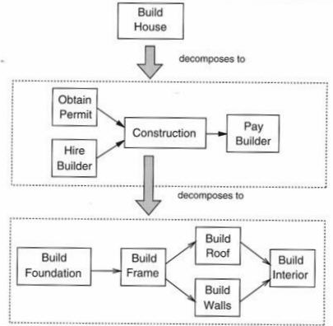

Slide 101
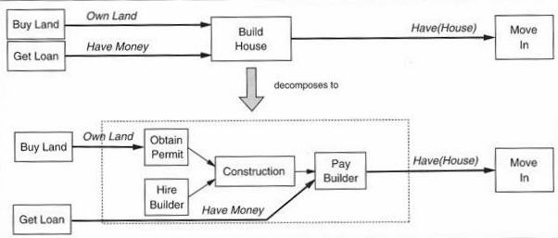

Slide 102
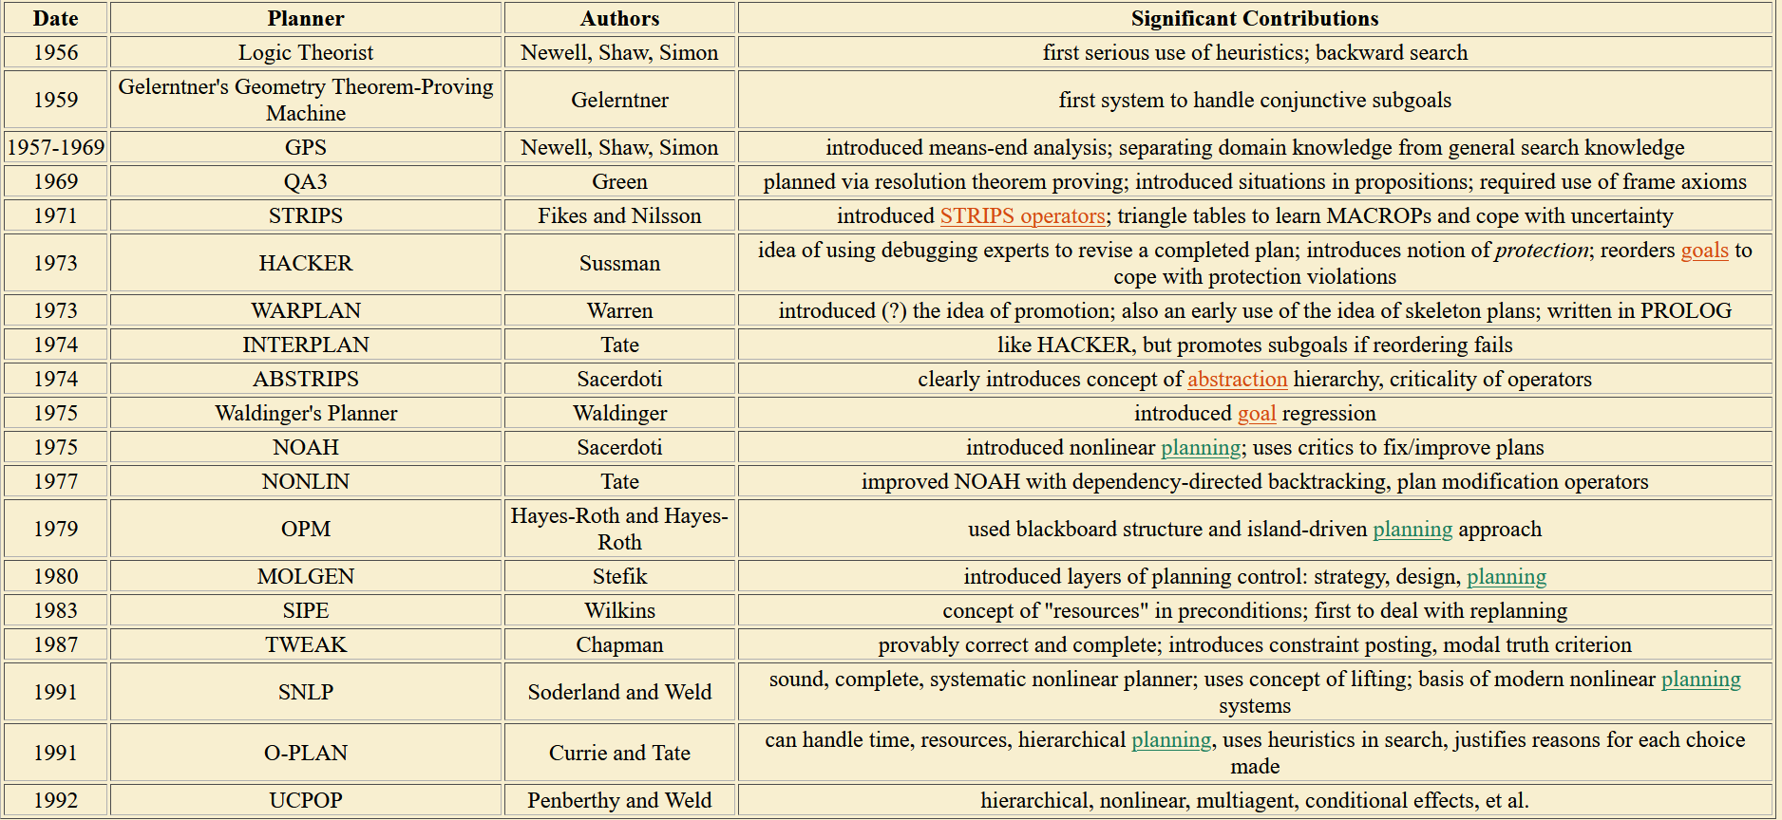
Timeline of Planner

Slide 103
Summary
Logical agents apply inference to a knowledge base to derive new information and make decisions
Basic concepts of logic:
syntax: formal structure of sentences
semantics: truth of sentences wrt models
entailment: necessary truth of one sentence given another
inference: deriving sentences from other sentences
soundness: derivations produce only entailed sentences
completeness: derivations can produce all entailed sentences
Wumpus world requires the ability to represent partial and negated information, reason by cases, etc.
Resolution is complete for propositional logic Forward, backward chaining are linear-time, complete for Horn clauses
Propositional logic lacks expressive power

